Slide 1
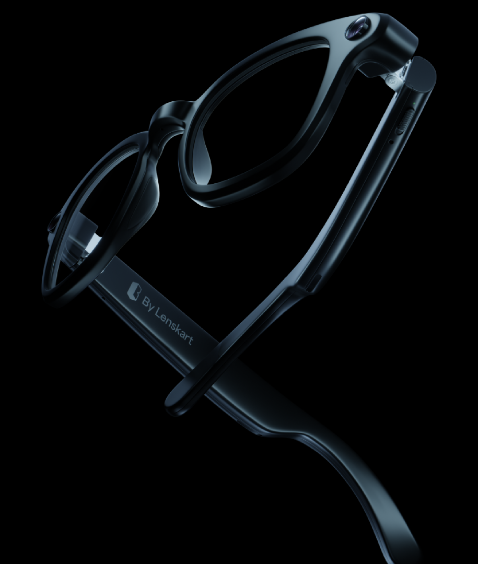
B Smart Glasses Companion App
Built for Lenskart
What actually deserves to be in your line of sight all day?

Slide 2
01
I worked on the companion app for smart glasses and led the design end-to-end.
02
What I worked on
My focus was simple, make this usable for someone who has never used something like this before.
03
I mainly worked on onboarding, Buddy (voice interaction), and core app flows.

Slide 3
01
We started by understanding what the business actually wanted to build.
02
Starting point
And we weren’t early here, Ray-Ban Meta smart glasses were already in the market, so expectations were already set.
03
Can’t show detailed research data here due to NDA, but these are the key things that came out of it.

Slide 4
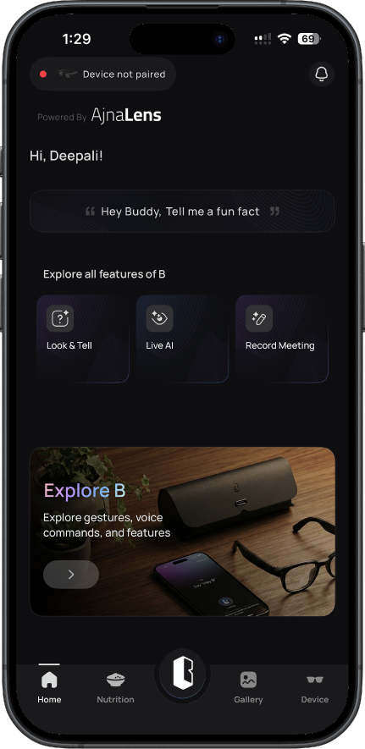
What the product actually looks like
This is the companion app that connects with the glasses.
It handles everything, device pairing, gallery, settings, and how users interact with the glasses through the phone.
The challenge here was not just features, but making sure nothing feels overwhelming.

Slide 5
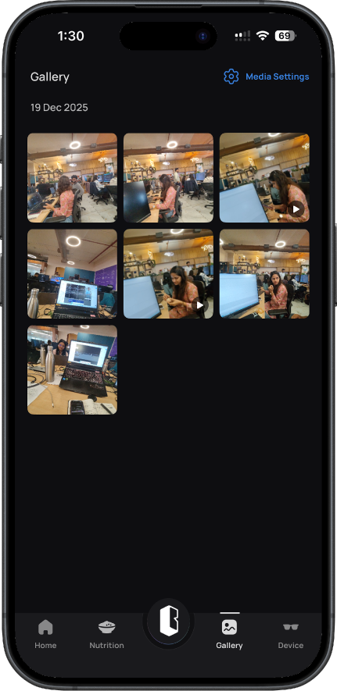
Core Usage (Gallery)
This is what people actually come back for.
Capturing moments
Viewing and managing gallery
Had to keep this simple. No one wants to dig through menus for things they use daily.

Slide 6
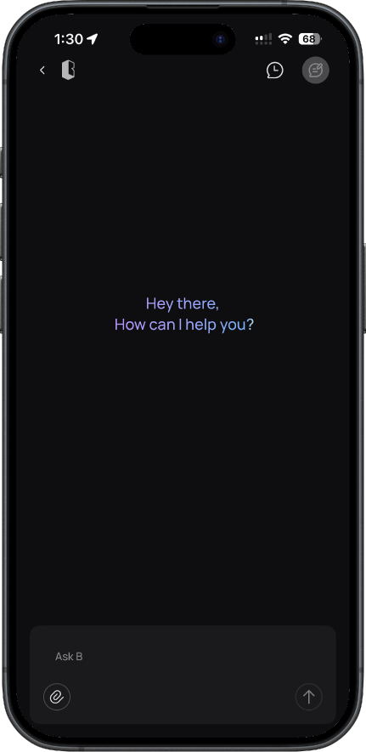

Making Buddy feel natural
One big part was Buddy.
We didn’t want it to feel like a command tool. It had to feel natural.
So I focused on how conversations should work, when it listens, how it responds, and how much it speaks.
Even small things like “Say Hey Buddy” needed to feel obvious, not awkward.
See how it works

Slide 7
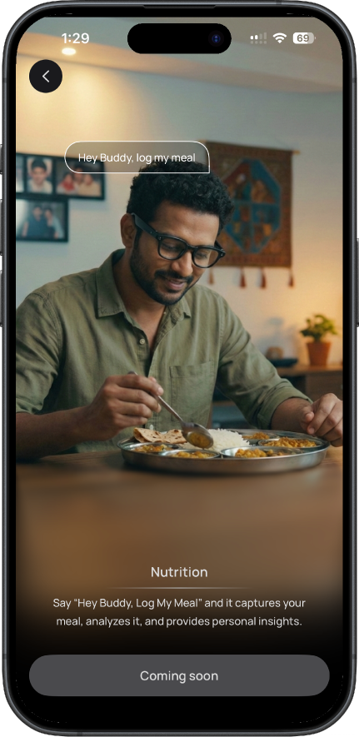


Slide 8
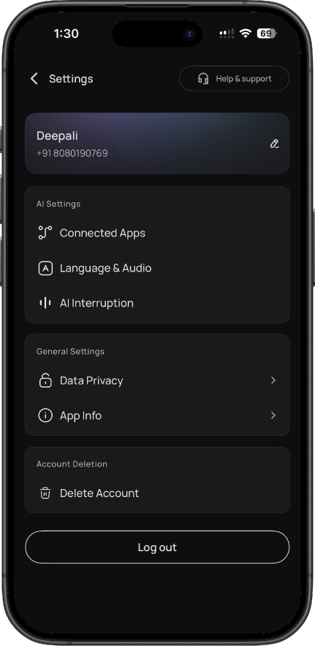
Control + Interaction (App as bridge)
The app is basically the bridge between user and glasses.
Settings and customization
Managing how the glasses behave
Controlling interactions through the phone
The challenge here wasn’t adding features, it was making sure nothing feels overwhelming.

Slide 9
Where things broke
01
02
03
Early on, users were confused.
Not because the product was bad, but because this whole category is new.
People who had used Ray-Ban Meta smart glasses picked it up faster.
But most users don’t come with that context.
Some just buy it out of curiosity.
So we had to design for zero familiarity.

Slide 10
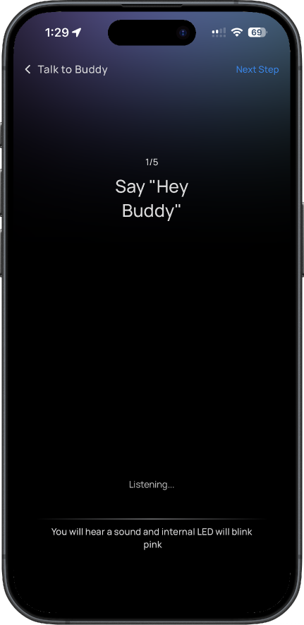
What actually helped
Interactive tutorials made a big difference.

Slide 11
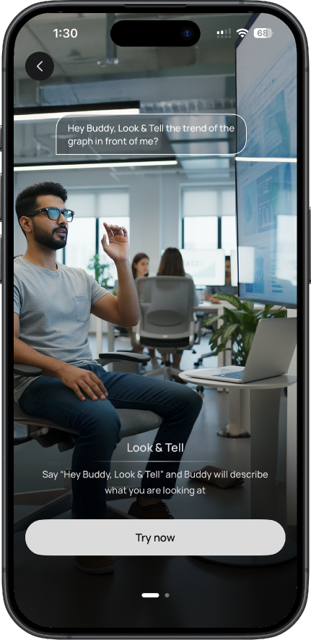
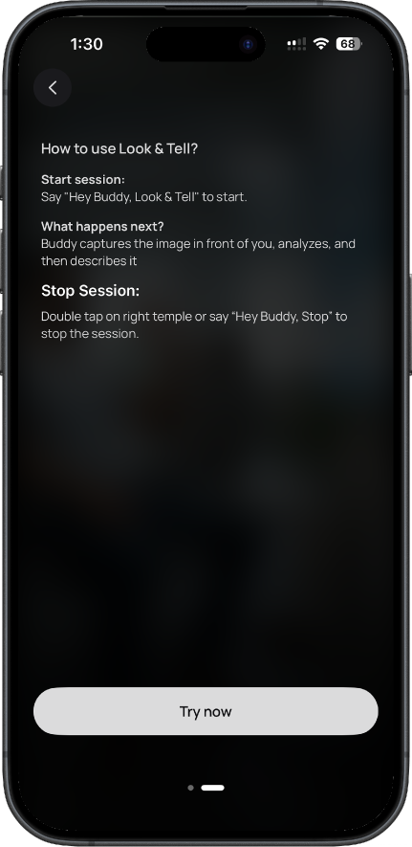
Instead of just explaining features, we guided users while they were using them.
This reduced hesitation a lot. People felt more comfortable using both the app and the glasses.

Slide 12
This wasn’t a one-shot design.
We kept running UATs, fixing confusion points, simplifying flows.
A lot of things looked good initially but didn’t help in real use, those had to go.
Iterations

Slide 13
When you’re designing for something new like this, clarity matters more than features.
If users don’t understand it in the first few minutes, they won’t stay long enough to see its value.
What I learned

